Slide 1
Applications of Bayesian Additive Regression for Cybersecurity
Rakesh Ravi K U
Notes:
Hi! I am Rakesh and I am gonna talk about the application of Bayesian Additive Regression for cybersecurity.

Slide 2
Objective
To successfully Implement Bayesian Additive Regression Trees (BART) on a Cybersecurity Dataset (CTU-13).
To compare the performance of BART with other traditional algorithms.
Notes:
The objective of the project is to implement Bayesian additive regression trees to detect malicious activity on the CTU-13 data set. In addition to implementation, I will be comparing the performance of BART with other machine learning algorithms.

Slide 3
Why isn’t XGBoost the end all solution?
Prone to Overfitting
No regularizing options
Difficult to interpret
Notes:
XGBoost is a model that will give you the best results for 75% if the Kaggle competitions and is also extensively used in the industry. But there are a few issues, due to the sequential nature of the ensemble, XGBoost has a tendency to overfit. Other than changing the hyperparameters, we do not have many options that can be used for regularization. Finally, they are difficult to interpret.

Slide 4
Bayesian Additive Regression Trees
Sequential Ensembling of Trees (With Prior Assumptions)
Markov Chain Monte Carlo
Metropolis Hastings
Back fitting Algorithm
Notes:
Enter BART. Bayesian additive regression trees uses sequential ensembling of trees, MCMC, Metropolis Hastings convergence algo and a back fitting algo.

Slide 5
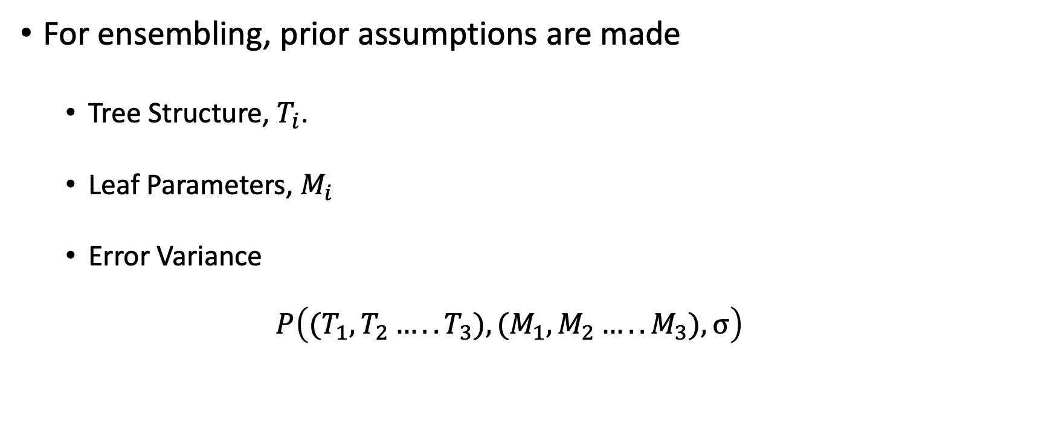
Ensemble of Trees
For ensembling, prior assumptions are made
Tree Structure, $T_{i}$.
Leaf Parameters, $M_{i}$
Error Variance
$$P\left({(T}_{1},T_{2}…..T_{3}),{(M}_{1},M_{2}…..M_{3}),σ\right)$$
Notes:
For the ensembling trees, we first make prior assumptions on Tree Structure, Leaf Parameters and Error variance.

Slide 6
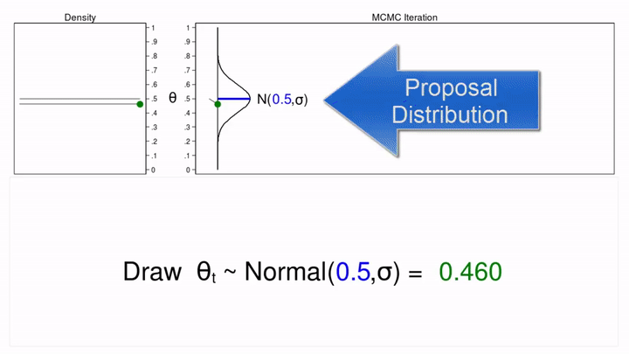
Monte Carlo Simulations
Notes:
Here is an example of MC simulation where the proposed distribution

Slide 7
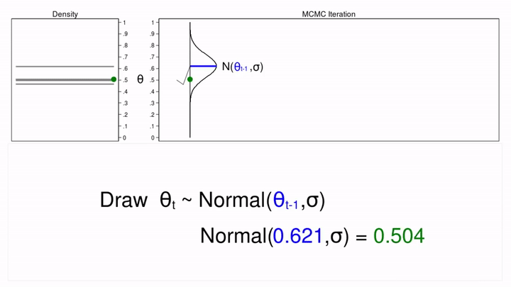
Markov Chain Monte Carlo Simulations
Notes:
In the case of BART, we have sequential trees. A parameter draws depend on the previous draw, it makes sense to use MCMC. Explain random walk. In order to solve for the KD being very different from a proposed distributions.

Slide 8
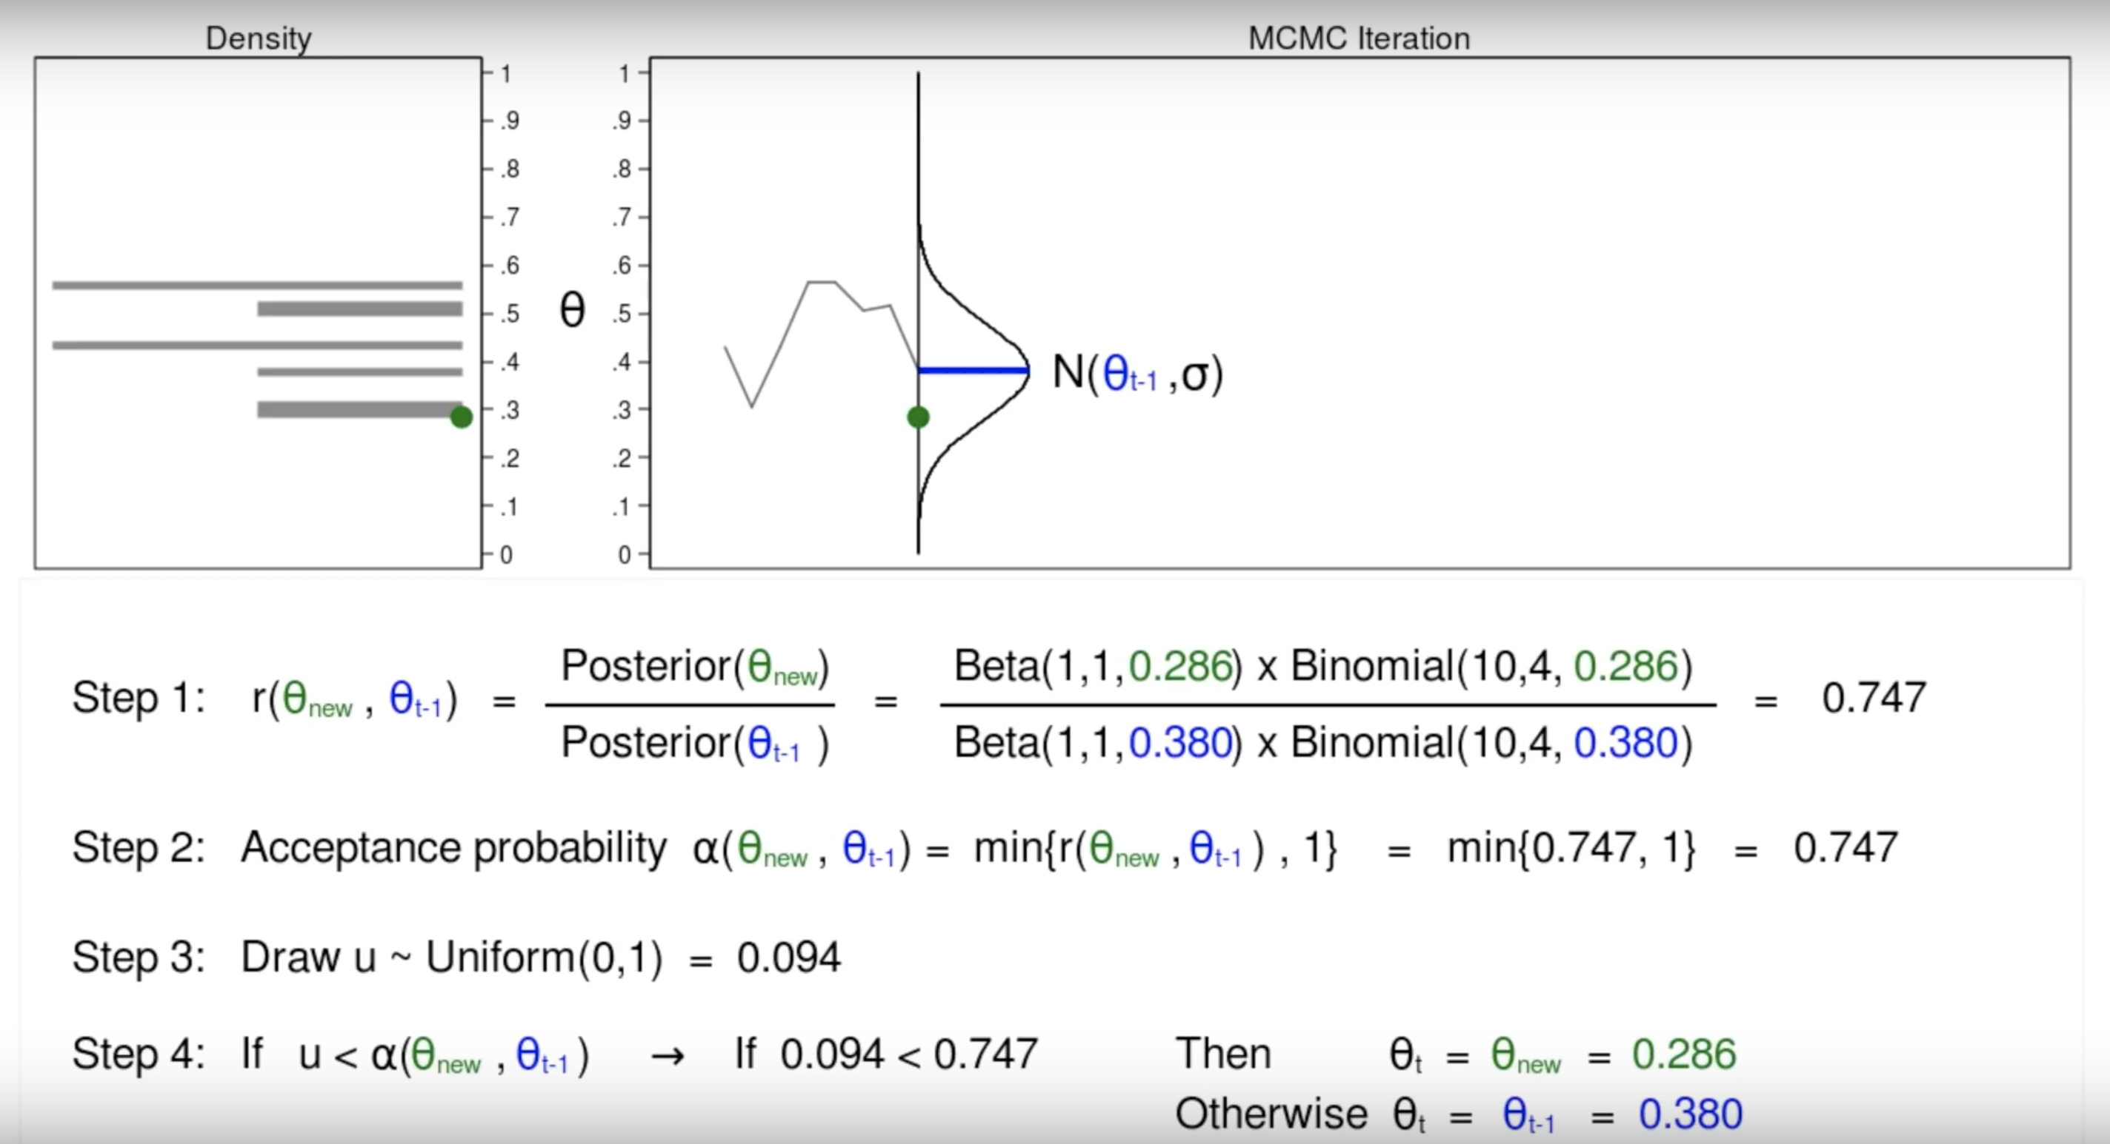
Metropolis Hastings Convergence Algorithm
Notes:
As the MCMC iterations tend to waver quite a bit, its important to stabilize the distribution which is where the Mtropolis Hastings Algo comes into a play. It calculates a statistic that incorporates the posterior of the new parameters and posterior of the parameters in the last iteration. An acceptance probability is calculated to check if the new parameters should be accepted or not. If the new parameters are not satisfactory, a random draw is performed from a uniform distribution between 0 and 1. this is how the splits are chosen.

Slide 9
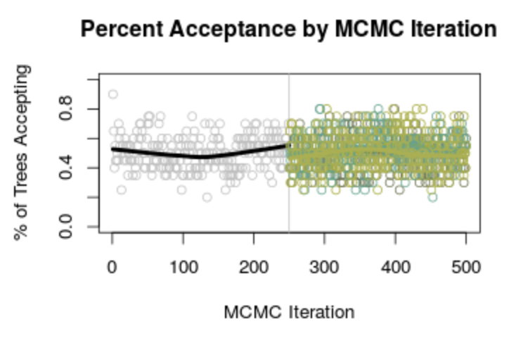
Disadvantages?
High dependence of starting values – Burn-in Period
Autocorrelation (sometimes) – thinning (Picking random samples our random samples)
Notes:
Although this may seem like an elegant solution, there is a high dependence of starting values. Most applications have incorporated called a burn-in period that rejects the first few iterations which are required for reaching convergence or stabilization. Autocorrelations occurs sometimes which can be avoided by using a process called thinning which is a random sample over a random sample.

Slide 10
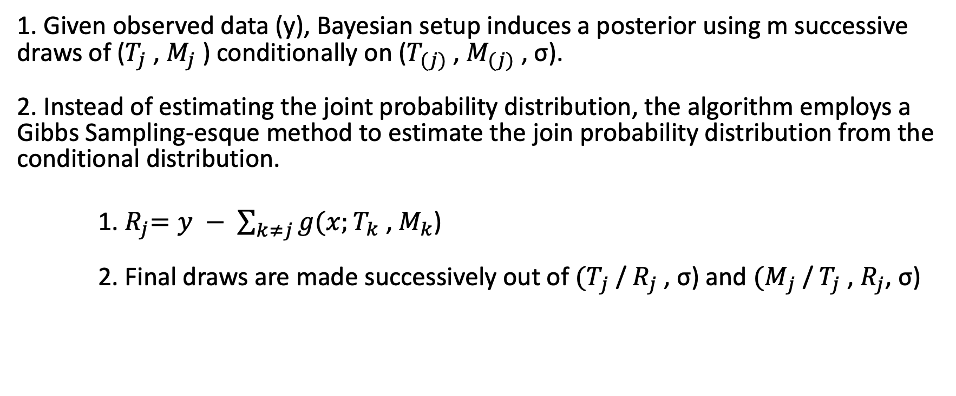
Back fitting Algorithm
1. Given observed data (y), Bayesian setup induces a posterior using m successive draws of ($T_{j}$ , $M_{j}$ ) conditionally on ($T_{(j)}$ , $M_{(j)}$ , σ). 2. Instead of estimating the joint probability distribution, the algorithm employs a Gibbs Sampling-esque method to estimate the join probability distribution from the conditional distribution.
1.${ R}_{j}=y − \sum_{k≠j}{g(x;}T_{k}$ , $M_{k}$) 2. Final draws are made successively out of ${(T}_{j}$ / $R_{j}$ , σ) and ${(M}_{j}$ / $T_{j}$ , $R_{j}$, σ)

Slide 11

CTU Dataset
Five Tuples
Source IP
Source Port
Transfer Protocol
Destination IP
Destination Port
Categorical Features
Connection Characteristics
Source Packets
Source Bytes
Connection History
Destination Packets
Destination Bytes
Numerical Features

Slide 12
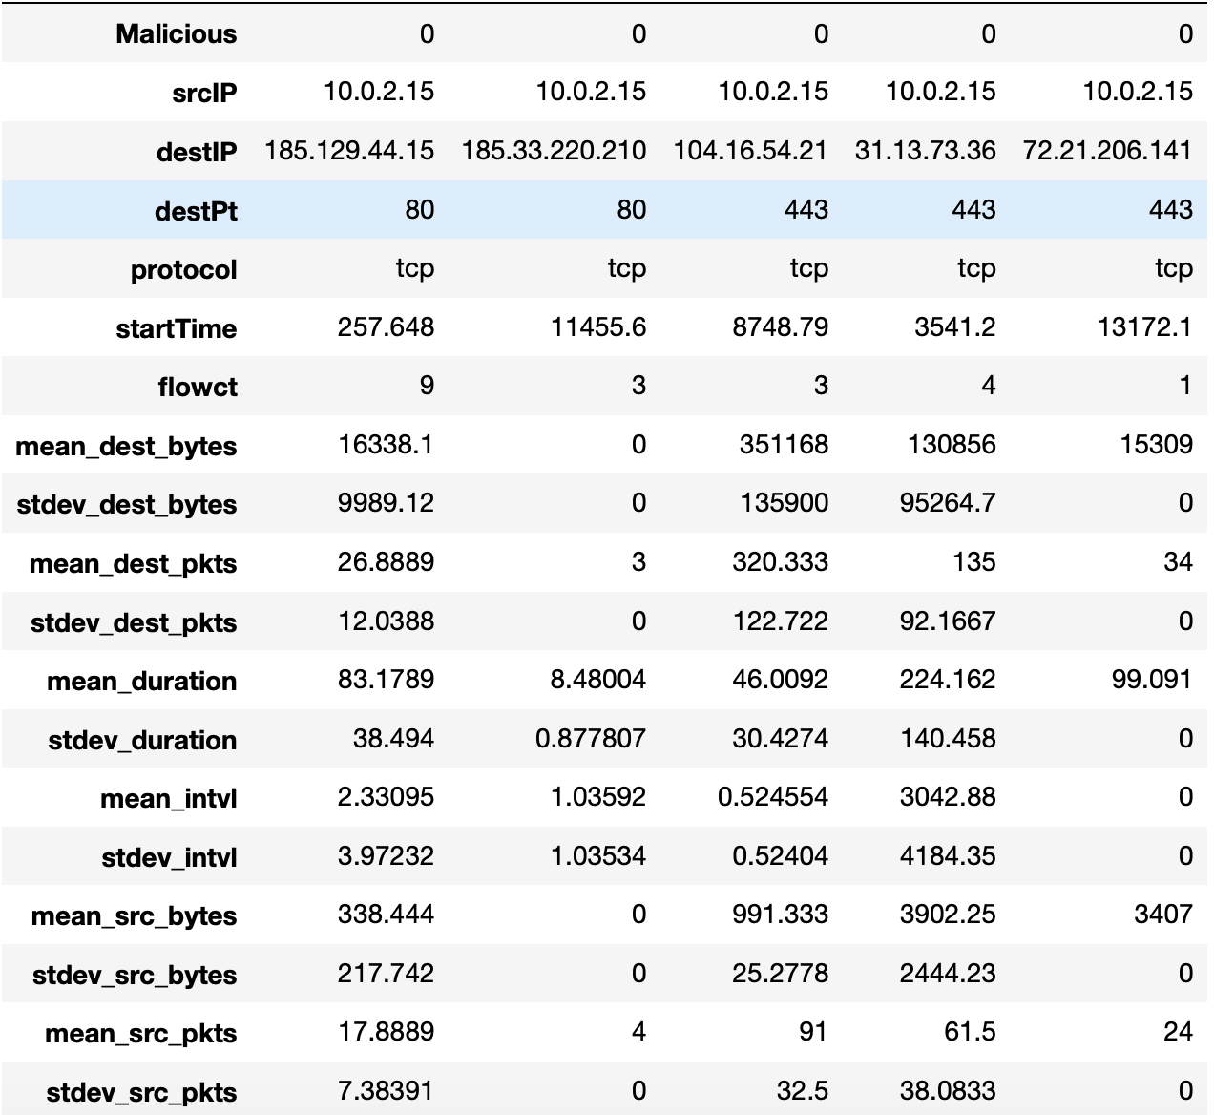
Connections to Traces

Slide 13
Results
Metrics | Logistic Regression | Gradient Boosting Classifier | Bayesian Additive Regression Trees
Accuracy | 0.991 | 0.995 | 0.996
False Positive Rate | 0.253 | 0.162 | 0.114
Precision | 0.982 | 0.990 | 0.997
Recall | 0.953 | 0.982 | 0.996

Slide 14
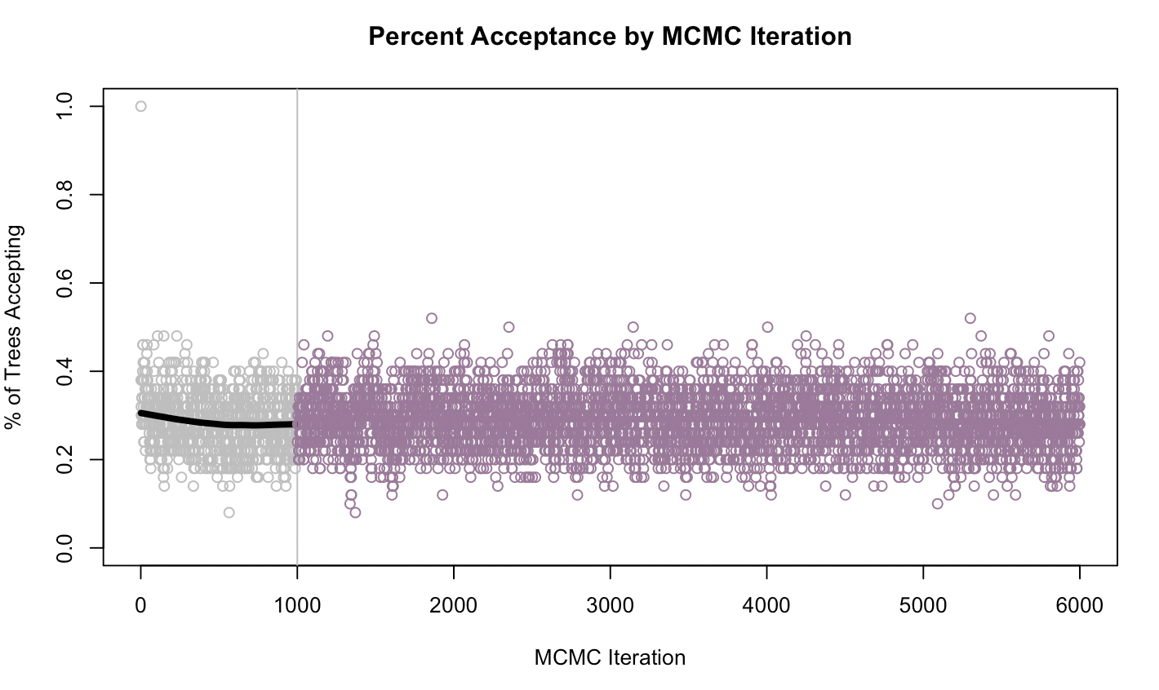
Model Optimization Investigation
Best performance was recorded with 6000 MCMC iterations with a burn-in of 1000 iterations.

Slide 15
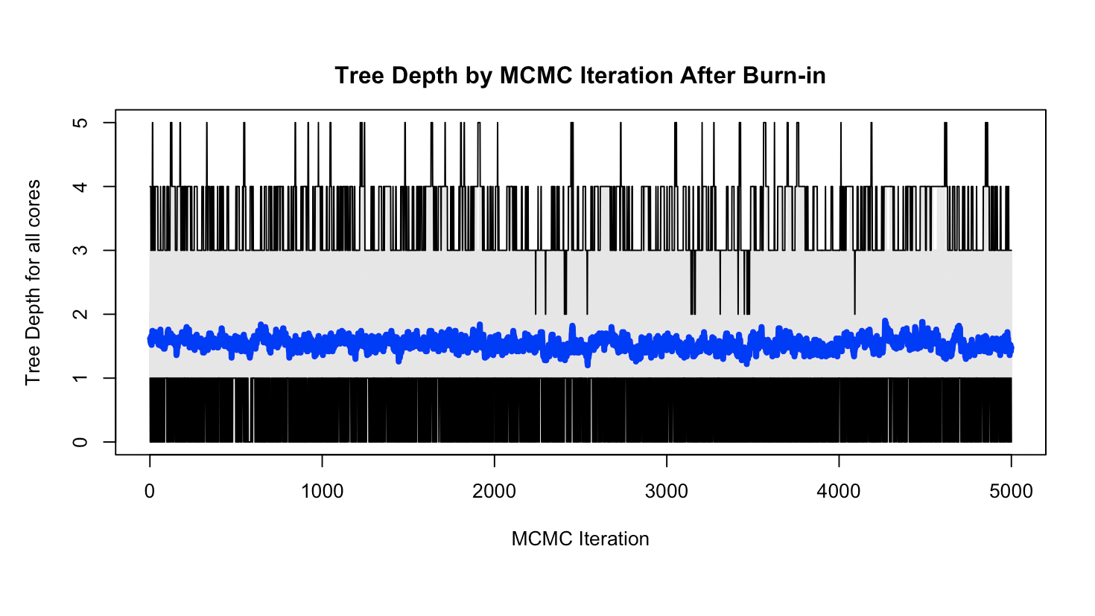
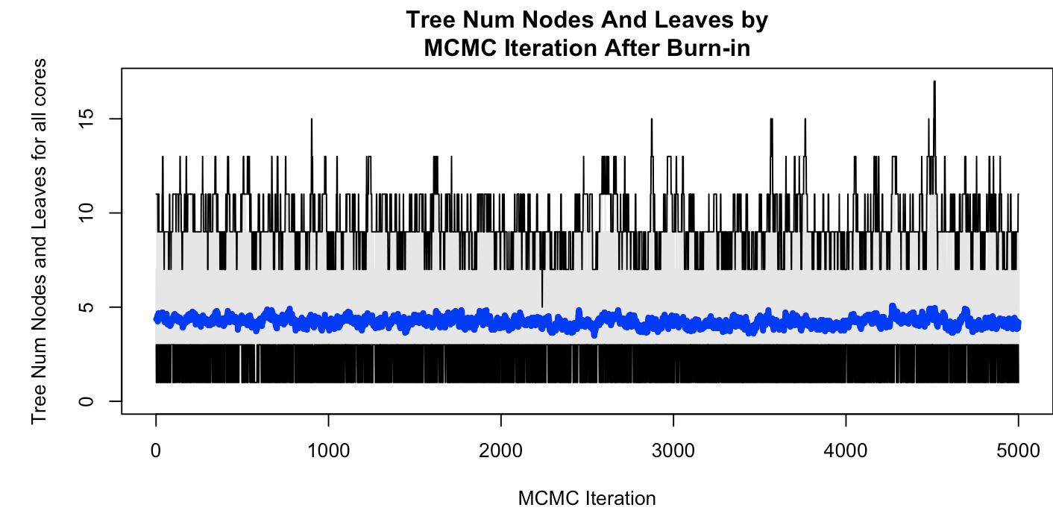
Model Diagnostics

Slide 16
Limitations
Computationally Expensive – Does not scale well.
Although dependence on starting values can be reduced to a large extent, it can still bias the model in some cases.
Model diagnostics and evaluation take as long to run as the model itself – because most diagnostics repeat the models.
No support in Python

Slide 17
Conclusions
BART is a additive tree model that performs better than most traditional machine learning models.
With 5000 MCMC iterations after burn-in of 1000 iteration were necessary to beat the performance of gradient boosting classifier

